Slide 1
HTML for beginners part 2

Slide 2
Hello world!
I AM TSHOLOFELO POLE
I am a software engineer at Entelect.
You can find me at:
Tsholofelo.pole@entelect.co.za

Slide 3
Recap
Building blocks of every website
HTML elements and tags
Created your first HTML doc
Started working on our CV

Slide 4
Recap: Basic HTML page
<!DOCTYPE html>
<html>
<head>
<meta charset=utf-8>
<meta name=viewport content="width=device-width,initial-scale=1">
<title>My title</title>
</head>
<body>
</body>
</html>

Slide 5
Today
Some structural elements
Tags to group our data
Lists
Semantic tags
Attributes
Use these new tags

Slide 6
1
Structual elements
Lists are important!

Slide 7
Lists
Ordered lists
<ol></ol>
Unordered lists
<ul></ul>
List items
<li></li>
Notes:
This is the first time we find a ‘partnership’ - <ol> and <ul> cannot exist without <li> - won’t cause a problem when you try code it this way, but it just won’t really look like much.
Use ordered lists to structure content where order is important
Unordered lists can be used to display a list of items in which the order is not important

Slide 8
Lists
<h3>My names:</h3>
<ol>
<li>Mary</li>
<li>Elizabeth</li>
</ol>
<h3>My hobbies</h3>
<ul>
<li>Reading</li>
<li>Baking</li>
</ul>
Ordered list
<ol></ol>
Unordered list
<ul></ul>
List items
<li></li>
Notes:
This is the first time we find a ‘partnership’ - <ol> and <ul> cannot exist without <li> - won’t cause a problem when you try code it this way, but it just won’t really look like much.
Use ordered lists to structure content where order is important
Unordered lists can be used to display a list of items in which the order is not important

Slide 9
Lists
<h3>My names:</h3>
<ol>
<li>Mary</li>
<li>Beth</li>
</ol>
<h3>My hobbies</h3>
<ul>
<li>Reading</li>
<li>Baking</li>
</ul>
Ordered list
<ol></ol>
Unordered list
<ul></ul>
List items
<li></li>
Notes:
This is the first time we find a ‘partnership’ - <ol> and <ul> cannot exist without <li> - won’t cause a problem when you try code it this way, but it just won’t really look like much.
Use ordered lists to structure content where order is important
Unordered lists can be used to display a list of items in which the order is not important

Slide 10
Lists
<h3>My names:</h3>
<ol>
<li>Mary</li>
<li>Elizabeth</li>
</ol>
<h3>My hobbies</h3>
<ul>
<li>Reading</li>
<li>Baking</li>
</ul>
Ordered list
<ol></ol>
Unordered list
<ul></ul>
List items
<li></li>
Notes:
This is the first time we find a ‘partnership’ - <ol> and <ul> cannot exist without <li> - won’t cause a problem when you try code it this way, but it just won’t really look like much.
Use ordered lists to structure content where order is important
Unordered lists can be used to display a list of items in which the order is not important

Slide 11
Lists
<h3>My names:</h3>
<ol>
<li>Mary</li>
<li>Elizabeth</li>
</ol>
<h3>My hobbies</h3>
<ul>
<li>Reading</li>
<li>Baking</li>
</ul>
Ordered list
<ol></ol>
Unordered list
<ul></ul>
List items
<li></li>
Notes:
This is the first time we find a ‘partnership’ - <ol> and <ul> cannot exist without <li> - won’t cause a problem when you try code it this way, but it just won’t really look like much.
Use ordered lists to structure content where order is important
Unordered lists can be used to display a list of items in which the order is not important

Slide 12
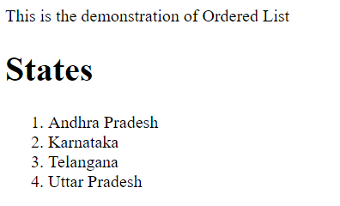
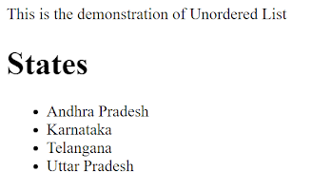
Lists
Ordered list
Unordered list
Notes:
By default, the list items in an ordered list begin with a number. To change the way list items are numbered, <ol> tag has an attribute “type”, through which list items can have numbers, roman numerals, or alphabets.
Ordered List – used to display each item which is preceded by Number or Alphabet Unordered List – used to display each item with a bullet by default, and does not use numbers or alphabets

Slide 13
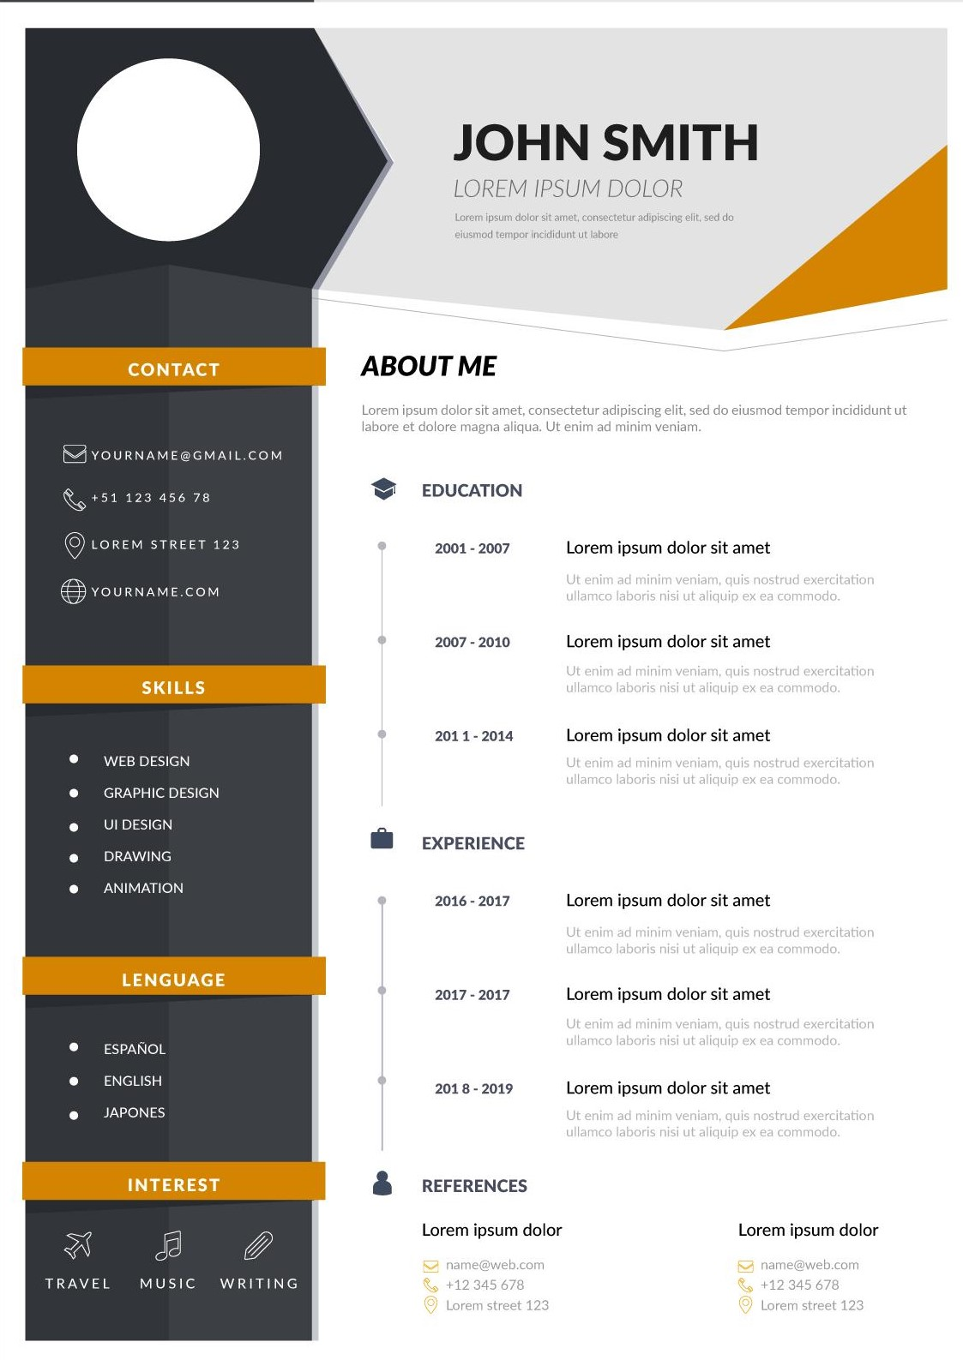
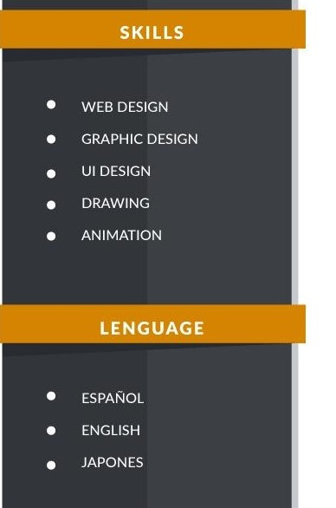

Slide 14


Slide 15
Activity: Add some lists to our CV
Add a heading to our CV
Add an ordered list for employment history
Add an unordered list for our skills

Slide 16
2
Semantic elements
Let’s group and structure our content.

Slide 17
Semantic elements
Clearly describe their meaning
Non semantic elements: <div> <span>
HTML has some semantic elements
Notes:
Clearly describes its meaning to both the browser and the developer
Gives us an idea about the content contained in the element
These semantic elements can be used to define different parts of a web page
Let’s go through some of these elements

Slide 18
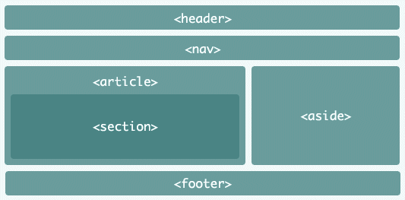
Semantic elements
Notes:
<header> - Defines a header for a document or a section
<nav> - Defines a set of navigation links
<section> - Defines a section in a document
<article> - Defines an independent, self-contained content
<aside> - Defines content aside from the content (like a sidebar)
<footer> - Defines a footer for a document or a section
<details> - Defines additional details that the user can open and close on demand
<summary> - Defines a heading for the <details> element

Slide 19
header
article
section
footer

Slide 20
Activity: Add semantic tags to our CV
Add <header> tag
Add <article> tag
Add <section> tag

Slide 21
3
Images and links
Let’s make our site interactive

Slide 22

Images
Add images to your page using
<img> </img>

Slide 23
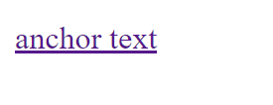
Links
Links are added using an anchor tag
<a>anchor text</a>

Slide 24
Activity: Add images to our CV
Add a link to your study institution
Add our picture to our CV

Slide 25


Slide 26
Attributes
Always specified in the start tag
name=“value” syntax
Always enclosed in quotation marks
Some elements have required attributes
<tag attribute=“value”> </tag>
Notes:
Attributes provide additional information, characteristics or properties of our elements
Attributes are always specified in the start tag.
Attributes usually consists of name/value pairs like: name="value“
Name is a rule/attribute name
Value is anything you want/what you want to set the attribute to
Same object/element/tag, different attributes

Slide 27
Attributes
One element/tag, multiple attributes
Some elements have required attributes
<ol
type=“a”
start=“2”
name=“myorderedlist”>
</ol>
Notes:
Same object/element/tag, different attributes
By default, the list items in an ordered list begin with a number. To change the way list items are numbered, <ol> tag has an attribute “type”, through which list items can have numbers, roman numerals, or alphabets.
list items to start numbering from lower case alphabets

Slide 28
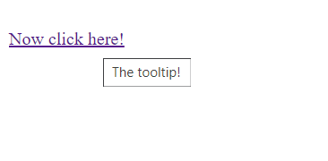
Anchor tag attributes
<a>
href – hypertext reference
title – tooltip
Anchor text
Tooltip
Notes:
Href: link that will be opened when your anchor text is clicked

Slide 29
Image tag attributes
<img>
src – the image source
width – image width
height – image height
alt – alternate text
https://www.w3schools.com/html/html_filepaths.asp

Slide 30
Activity: Add attributes to our CV
Add attributes to our image
Add attributes to our link

Slide 31
Quotations are commonly printed as a means of inspiration and to invoke philosophical thoughts from the reader.

Slide 32
header
nav
section
article
section
footer
section

Slide 33
Thanks!
ANY QUESTIONS?
You can find me at:
tsholofelo.pole@entelect.co.za

